Slide 1
Voucher Creation Application for Island-Hopping Booking
A project proposal by: Joshua Arnel Gonzales

Slide 2
Table of Contents
Information Gathering
Problem Identification and Project Goal Setting
Project Methodology
Work Breakdown Structure
Project Team
Project Costs
Project Monitoring

Slide 3
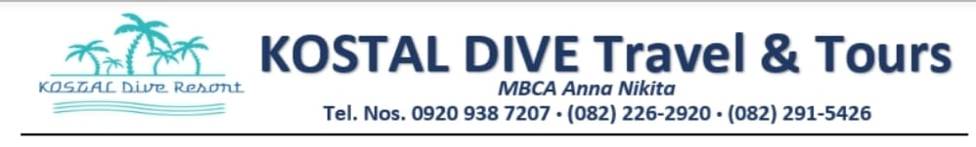
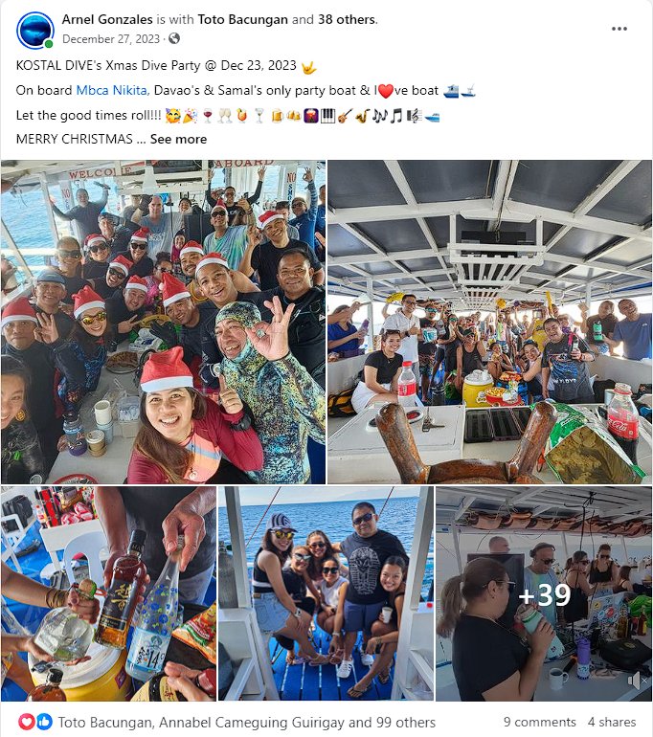
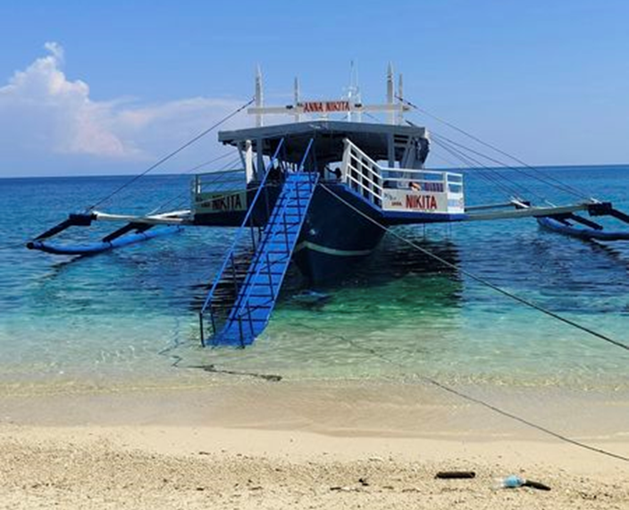
Information Gathering (Activity 1.1):
Kostal Dive Travel and Tours offers boat rentals and island-hopping services for water sports enthusiasts and partygoers. The business specializes in scuba diving and island-hopping services.
The business owner manages all the operations and delegates tasks to the trip coordinators and the boat crew.

Slide 4
How does the company execute their project plan?
1. The customer contacts the business owner or coordinator to book a trip.
2. The customer provides a list of the details and information of the following guests.
3. The coordinator will then create the proper documents (Vessel Entry Permit and Island-Hopping Voucher) with the corresponding guest details.
4. The coordinator will then have the documents approved by the Coast Guard and acquire the official receipt/permit.
5. The boat will then sail and provide the paid services to the guests.
6. The guests will transact payments to the business owner for the services they got.

Slide 5
Current Issues/concerns needs to be address:
1. Creation of the required documents (Vessel Entry Permit and Island-Hopping Voucher) is manual and slow.
2. Guest details are repeatedly requested even from frequent customers.
3. Recordkeeping of documents from previous boat trips is haphazardly kept in stacks of paper.

Slide 6
Problem Identification (Activity 1.2):
Problem Statement:
The current document creation process for boat travel is inefficient and hinders business operations. Manual cross-referencing introduces the risk of errors, and the absence of the means to record guest details leads to repetitive requesting even from frequent guests. Faulty recordkeeping in paper stacks further complicates matters, posing obstacles to daily processes and potential scalability.
Goals:
Improve efficiency and accuracy of document creation.
Find a way that guest information can be stored and referenced easily.
Improve recordkeeping of approved documents
Objectives:
Introduce a system that allows digital encoding of documents that increases efficiency by streamlining input of repetitive information and decreases cause for inaccuracy
Integrate guest information history into the system that allows autocompletion and suggestion function
Allow the system to save and delete documents to simulate recordkeeping.

Slide 7
Scope and Purpose of the Project:
This project focuses solely on enhancing and optimizing the business processes and transactions of Kostal Dive Travel and Tours. It does not encompass other affiliated businesses or institutes. The goal is to develop an application that aligns with the company's objectives, promoting efficiency, scalability, document accuracy, and customer satisfaction for the benefit of the business and its stakeholders.

Slide 8
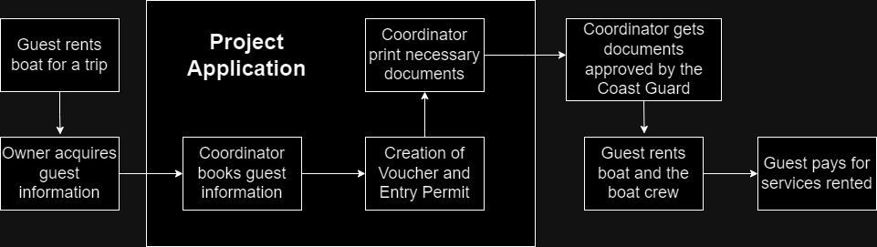
Activity # 2: Project System Model

Slide 9
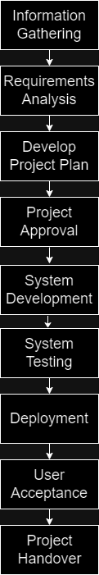
Activity # 3: Methodology
Information Gathering
Requirements Analysis
Develop Project Plan
Project Approval
System Development
System Testing
Deployment
User Acceptance
Project Handover

Slide 10
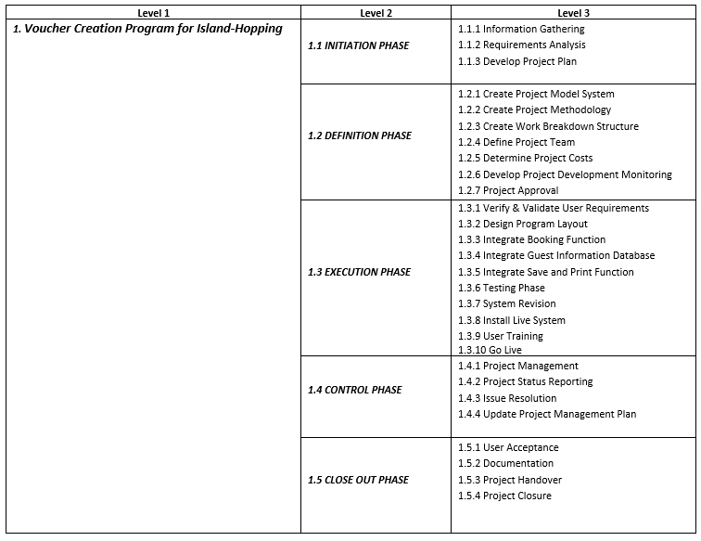
Activity # 4: Creating Work Breakdown Structure

Slide 11
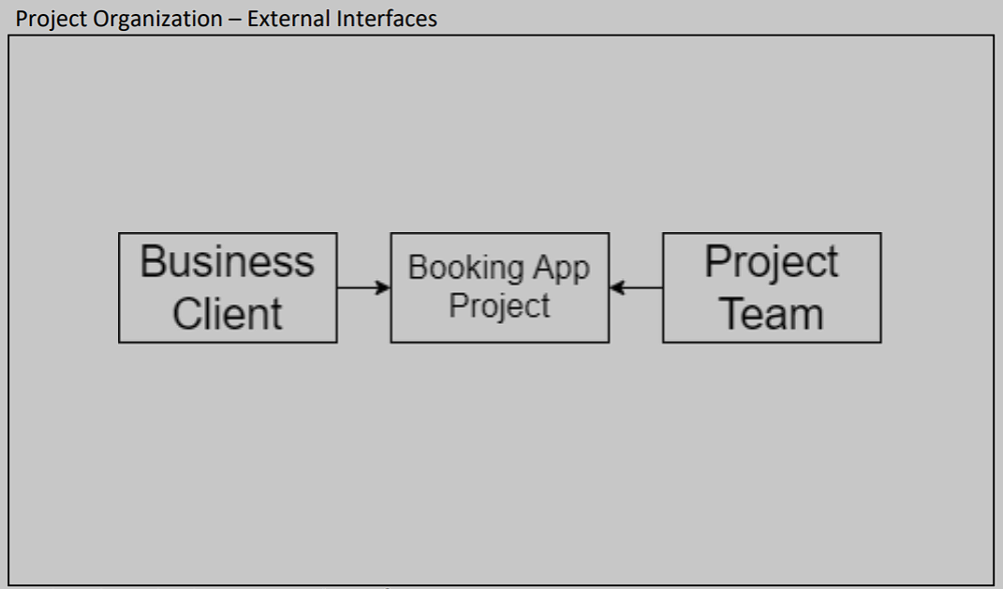
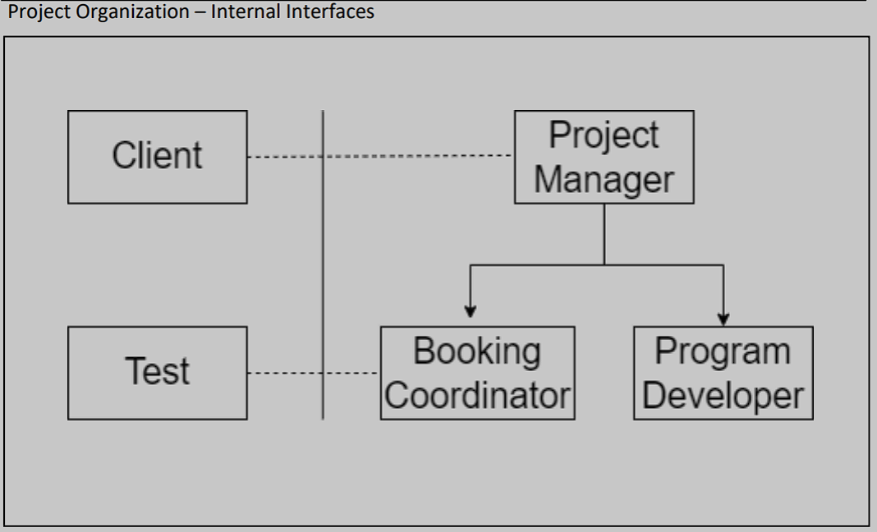
Activity # 5: Defining Project Team

Slide 12
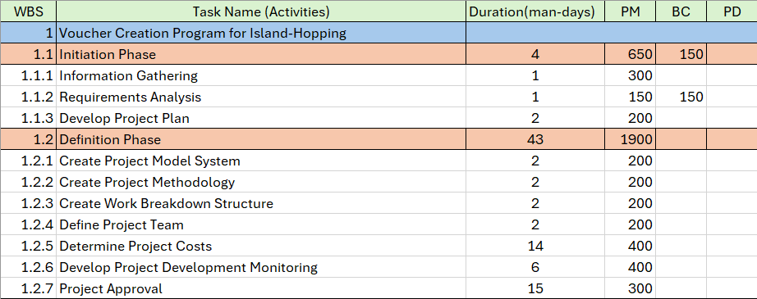
Project Costs (Activity #6):
WBS w/ cost (Initiation – Definition Phase):

Slide 13
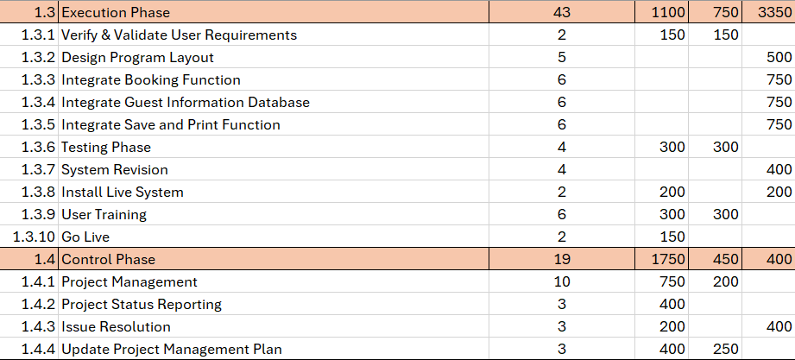
Project Costs (Activity #6):
WBS w/ cost (Execution – Control Phase):

Slide 14
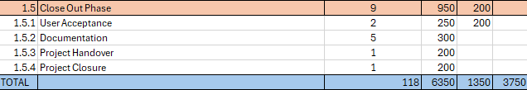
Project Costs (Activity #6):
WBS w/ cost (Close-Out Phase):

Slide 15
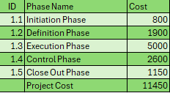

Project Costs (Activity #6):
Total Role Cost and Phase Cost:

Slide 16
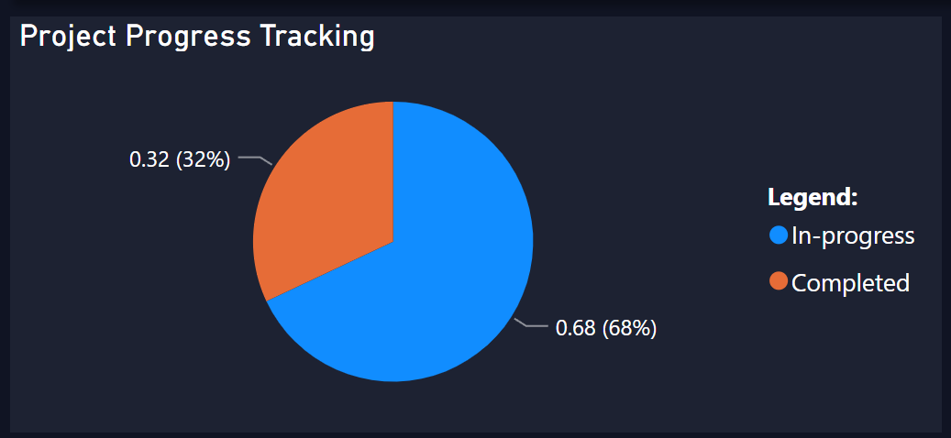
Project Monitoring (Activity #7):

Slide 17
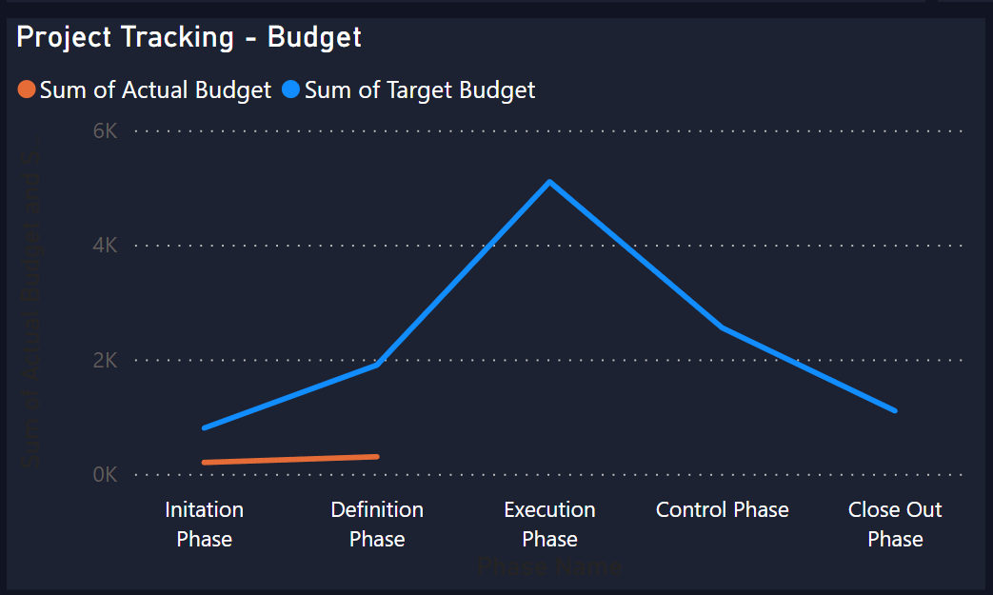
Project Monitoring (Activity #7):

Slide 18
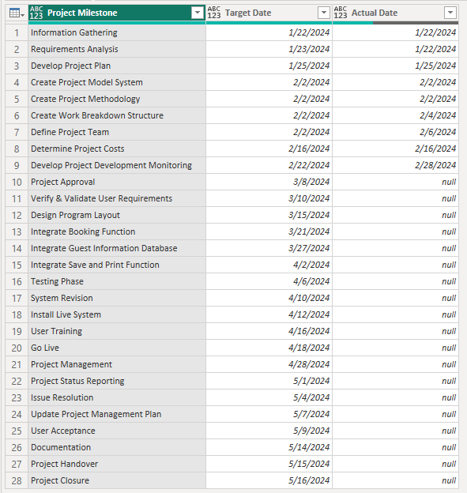
Project Monitoring (Activity #7):
Project Tracking Plan – Schedule:

Slide 19
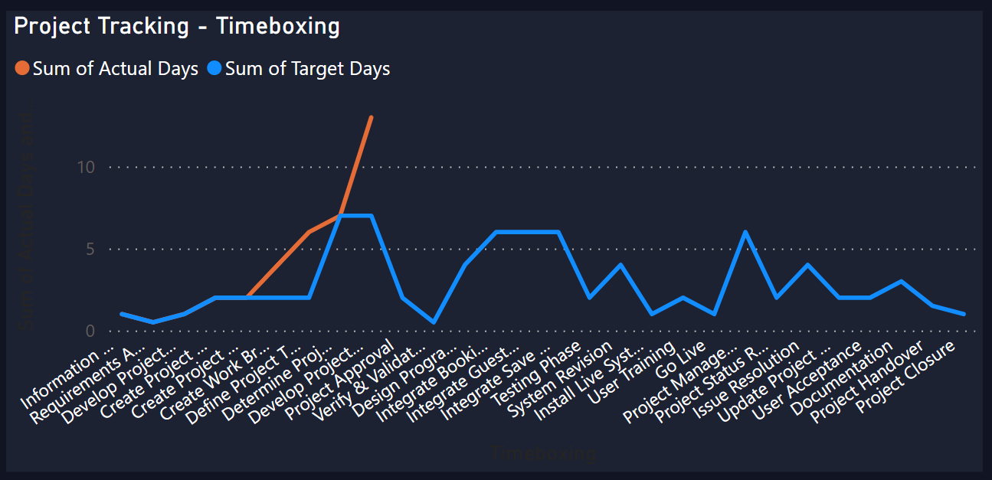
Project Monitoring (Activity #7):

Slide 20
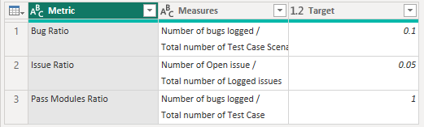
Project Monitoring (Activity #7):
Project Tracking Plan- Quality

Slide 21
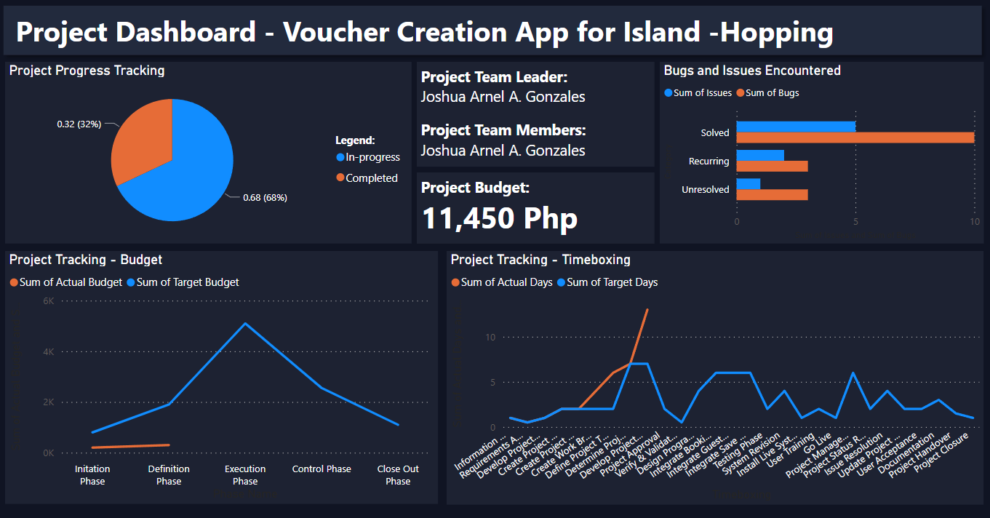
Project Monitoring (Activity #7):

Slide 22
thank you

